Slide 1


Slide 2

ReFS and Data Dedup – The 2019 edition Mike Resseler – Director Product Management, R&D @ Veeam Software

Slide 3

ReFS

Slide 4

Scalability

Slide 5

Performance

Slide 6

Cost

Slide 7

Integrity

Slide 8

Reliability

Slide 9

1 + 1 = 3

Slide 10
Deployment Models
Simple ReFS Volume
Fast Cloning and integrity streams
Shared Storage Spaces (S2S)
Poor Performance (parity) OR Poor Capacity (mirror)
Storage Spaces Direct (S2D)
Adds real-time storage tiering w/ SSD – Resolves S2S Performance Issue(s)
Does Require Datacenter Edition of Windows Server

Slide 11
Simple ReFS volume
Suitable for applications that provide their own resiliency and availability solutions
WILL detect corruption but can’t fix it

Slide 12
Storage Spaces
Suitable for hosting archival data and storing user documents
Built-in checksums, online repair (because multiple copies)
Efficiently scale and support massive data sets.

Slide 13
Storage Spaces Direct
Recommended for Virtualized workloads
Real-time tier optimization and cache
Built-in checksums, online repair (because multiple copies)
Efficiently scale and support massive data sets.

Slide 14
NTFS versus ReFS
Feature | NTFS | ReFS
Maximum File Length | 255 Unicode characters | 255 Unicode characters
Maximum path name length | 32K Unicode characters | 32K Unicode characters
Maximum file size | 256 TB | 35 PB
Maximum volume size | 256 TB | 35 PB

Slide 15
NTFS versus ReFS
Functionality | NTFS | ReFS
BitLocker Encryption | Yes | Yes
CSV Support | Yes | Yes
Soft links | Yes | Yes
Failover Cluster Support | Yes | Yes
ACL | Yes | Yes
USN Journal | Yes | Yes
Changes notifications | Yes | Yes
Junction Points | Yes | Yes
Mount Points | Yes | Yes

Slide 16
NTFS versus ReFS
Functionality | NTFS | ReFS
Reparse Points | Yes | Yes
Volume Snapshots | Yes | Yes
File IDs | Yes | Yes
Oplocks | Yes | Yes
Sparse files | Yes | Yes
Named Streams | Yes | Yes
Block Clone | No | Yes
Sparse VDL | No | Yes
Real-time tier optimization * (Renamed to Mirror-accelerated parity, S2D) | No | Yes

Slide 17
NTFS versus ReFS
Functionality | NTFS | ReFS
File System Compression | Yes | No
File System Encryption | Yes | No
Data Deduplication | Yes | No Yes
Transactions | Yes | No
Hard links | Yes | No
Object IDs | Yes | No
Short names | Yes | No
Extended Attributes | Yes | No
Disk quotas | Yes | No

Slide 18
NTFS versus ReFS
Functionality | NTFS | ReFS
Bootable | Yes | No
Page file support | Yes | No
Supported on removable media | Yes | No
NTFS storage tiers | Yes | No
Thin Provisioning ReFS: Storage Spaces only | Yes | Yes
Offloaded Data Transfer | Yes | No
Trim/ Unmap ReFS: Storage Spaces Only | Yes | Yes

Slide 19
Mirror-accelerated Parity
Delivers high performance & capacity efficient storage
Two logical tiers
Performance tier
Capacity tier
Writes occur in performance tier
Large chunks of data moved to capacity tier in real-time
Hybrid deployment: cache in S2D helps accelerate reads
Not recommended for virtualization & high-performance workloads. (use three-way mirrors for better performance)

Slide 20
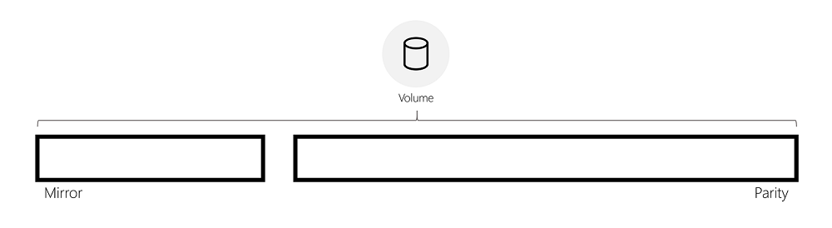
How it works

Slide 21
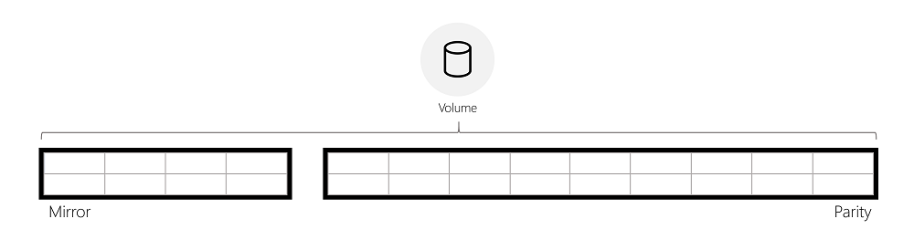
How it works

Slide 22
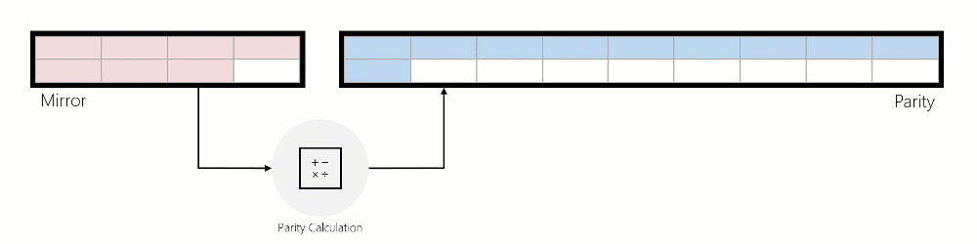
How it works

Slide 23

Writes to mirror

Slide 24
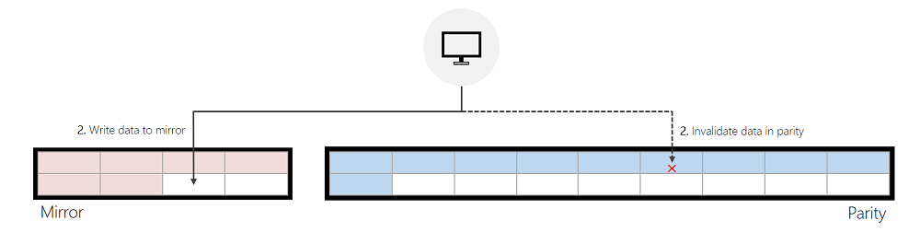
Writes to mirror, reallocated from Parity

Slide 25
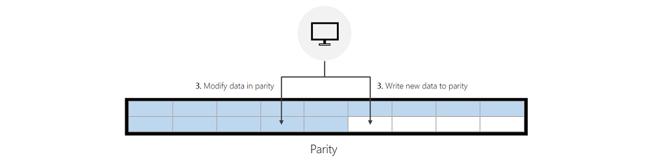
Writes to parity

Slide 26
IO performance
Writes: As a “rule of thumb”
Mirror tier fastest
Then reallocated writes
Then Parity tier
Read:
Same (when the same media type)
If different media type, the cache can help you

Slide 27
ReFS compaction
Only in fall’s semi-annual release (1709) and Windows Server 2019
Before: if mirror-tier becomes full, performance (could) degrade (heavily)
Compaction = freeing up space in mirror for hot data

Slide 28
Performance optimizations
Tip:
Place write-heavy VHDs in different subdirectories
Performance Counter
ReFS\Data allocations slow tier/sec ReFS\Metadata allocations slow tier/sec
Rotation Aggressiveness
Key: HKEY_LOCAL_MACHINE\System\CurrentControlSet\Policies
ValueName (DWORD): DataDestageSsdFillRatioThreshold
ValueType: Percentage

Slide 29
Performance optimizations
Increase the size of the mirrored tier
Resize-StorageTier -FriendlyName “Performance” -Size 20GB
Resize-StorageTier -InputObject (Get-StorageTier -FriendlyName “Performance”) -Size 20GB
TIP:
Resize the Partition and Volume after you resize the StorageTier

Slide 30
Sparse VDL
Sparse VDL = technique to zero files fast
What took previously minutes and hours now can be done in seconds

Slide 31
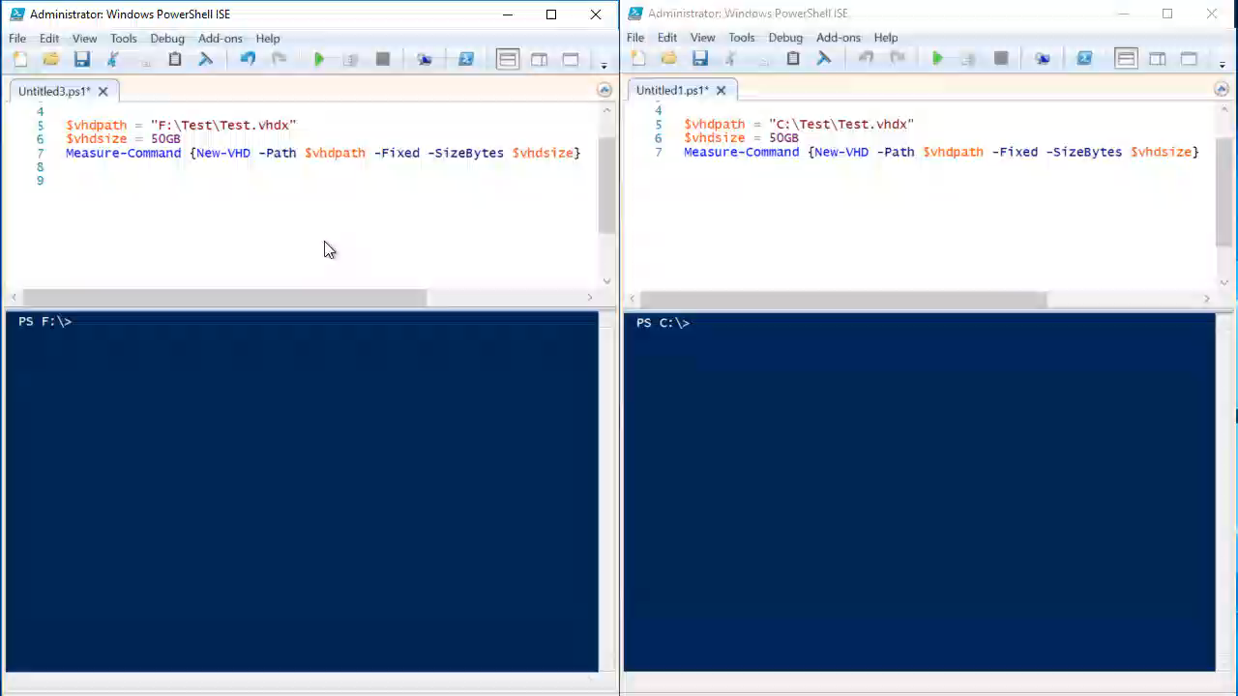
Demo

Slide 32
Block Cloning
Performs copies as a low-cost metadata operation
ReFS enables multiple files to share the same logical clusters (physical locations on a volume)

Slide 33
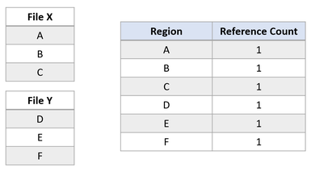
How does it work

Slide 34
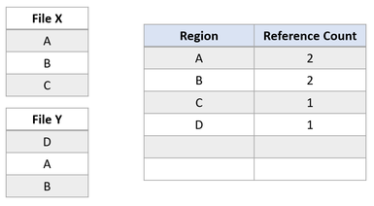
How does it work

Slide 35
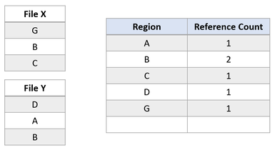
How does it work

Slide 36
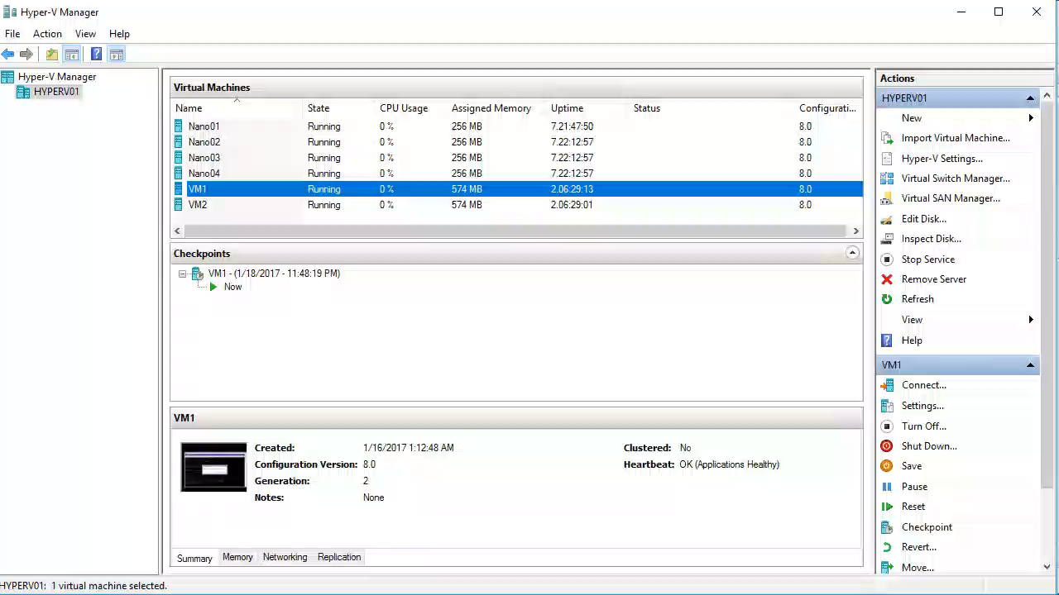
Hyper-V Example

Slide 37
Integrity Streams
Ensures consistency with allocate-on-write, so that data blocks are never modified in-place.
Enabled by default for metadata
Not for data itself!
Detects and notifies you about Bit Rot

Slide 38
How does it work
Uses Checksums
Can be enabled on Volume / File / Folder (with inheritance)
Before returning data, checksum is calculated
In case of checksum error
No data returned (when there is no additional copy)
Attempt to repair
Successful: Data returned
Not Successful: Error

Slide 39
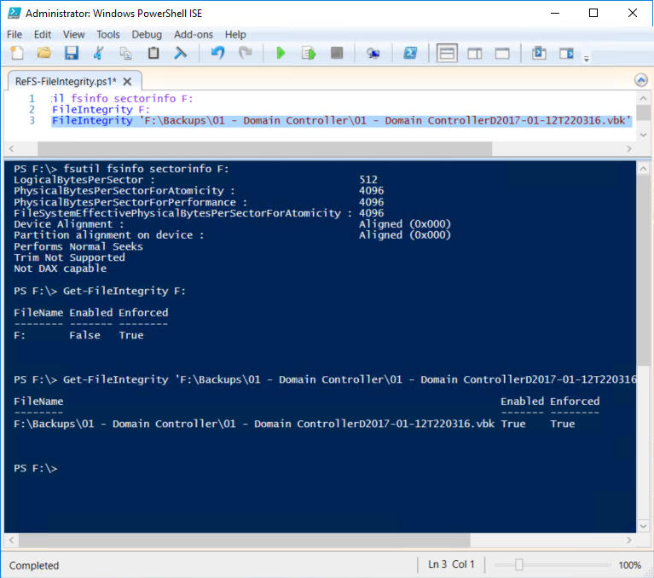

Slide 40
4k versus 64k
Source block = 506 KB

Slide 41
4k
Consumes 126.5 clusters so 127

Slide 42
64k
Consumes 7.9 clusters so 8

Slide 43
4k versus 64k: Per MFST
Per MSFT: https://blogs.technet.microsoft.com/filecab/2017/01/13/cluster-size-recommendations-for-refs-and-ntfs/
Use 4K:
IO amplification
Greater compatibility with Hyper-V I/O granularity
Use 64K:
large, sequential IO

Slide 44
4k versus 64k: From the field
Use 64K for larger volumes
Doesn’t kill the CPU / Memory

Slide 45
Good reads
Luca Dell’Oca:
http://www.virtualtothecore.com/en/refs-cluster-size-with-veeam-backup-replication-64kb-or-4kb/
Anton Kolomyeytsev
https://www.starwindsoftware.com/blog/log-structured-file-systems-microsoft-refs-v2-short-insight
https://www.starwindsoftware.com/blog/log-structured-file-systems-microsoft-refs-v2-investigation-part-1
https://www.starwindsoftware.com/blog/refs-performance

Slide 46
What we have learned…
Windows Server 2019
Windows Server 2016 with September 2018 updates or later (KB4343884)
Windows 10 Pro for Workstations
ReFS.sys driver version 2457 or later
Don’t use it if:
You need to boot from it
You need file level encryption (volume level does work)
You need disk quotas

Slide 47
What we have learned…
Issues are seen with CCM and 3rd party AV providers
Our advice: 1 GB memory per 1 TB but:
We stress tested 40 TB with only 8 GB
Backup of > 100 VMs, per VM-backup file
Weekly synthetic fulls
No spikes in CPU or RAM
Don’t use non-HCL hardware
we have seen volume loss on some of those, specifically on RAID controllers without battery-backed write cache

Slide 48
Counters
\ReFS(Drive:)\Allocation of Data Clusters on Fast Tier/sec::Sec
\ReFS(Drive:)\Allocation of Data Clusters on Slow Tier/sec::sec
\ReFS(Drive:)\Allocation of Metadata Clusters on Fast Tier/sec::Sec
\ReFS(Drive:)\Allocation of Metadata Clusters on Slow Tier/sec::Sec
\ReFS(Drive:)\Checkpoint latency (100 ns)::100ns
\ReFS(Drive:)\Checkpoints/sec::Sec
\ReFS(Drive:)\Compacted Container Fill Ratio (%)::%
\ReFS(Drive:)\Compaction Failure Count
\ReFS(Drive:)\Compaction read latency (100 ns)::100ns
\ReFS(Drive:)\Compaction write latency (100 ns)::100ns
\ReFS(Drive:)\Compactions failed due to ineligible container
\ReFS(Drive:)\Compactions failed due to max fragmentation
\ReFS(Drive:)\Container Destages From Fast Tier/sec::Sec
\ReFS(Drive:)\Container Destages From Slow Tier/sec::Sec
\ReFS(Drive:)\Container Move Failure Count
\ReFS(Drive:)\Container Move Retry Count
\ReFS(Drive:)\Container moves failed due to ineligible container
\ReFS(Drive:)\Current Fast Tier Data Fill Percentage::%
\ReFS(Drive:)\Current Fast Tier Metadata Fill Percentage::%
\ReFS(Drive:)\Current Slow Tier Data Fill Percentage::%
\ReFS(Drive:)\Current Slow Tier Metadata Fill Percentage::%
\ReFS(Drive:)\Data Compactions/sec::Sec

Slide 49
Counters
\ReFS(Drive:)\Data In Place Write Clusters/sec::Sec
\ReFS(Drive:)\Delete Queue entries
\ReFS(Drive:)\Dirty metadata pages
\ReFS(Drive:)\Dirty table list entries
\ReFS(Drive:)\Fast tier destage read latency (100 ns)::100ns
\ReFS(Drive:)\Fast tier destage write latency (100 ns)::100ns
\ReFS(Drive:)\Fast Tier Destaged Container Fill Ratio (%)::%
\ReFS(Drive:)\Log fill percentage::%
\ReFS(Drive:)\Log writes/sec::Sec
\ReFS(Drive:)\Slow tier destage read latency (100 ns)::100ns
\ReFS(Drive:)\Slow tier destage write latency (100 ns)::100ns
\ReFS(Drive:)\Slow Tier Destaged Container Fill Ratio (%)::%
\ReFS(Drive:)\Total Allocation of Clusters/sec::Sec
\ReFS(Drive:)\Tree update latency (100 ns)::100ns
\ReFS(Drive:)\Tree updates/sec::Sec
\ReFS(Drive:)\Trim latency (100 ns)::100ns

Slide 50
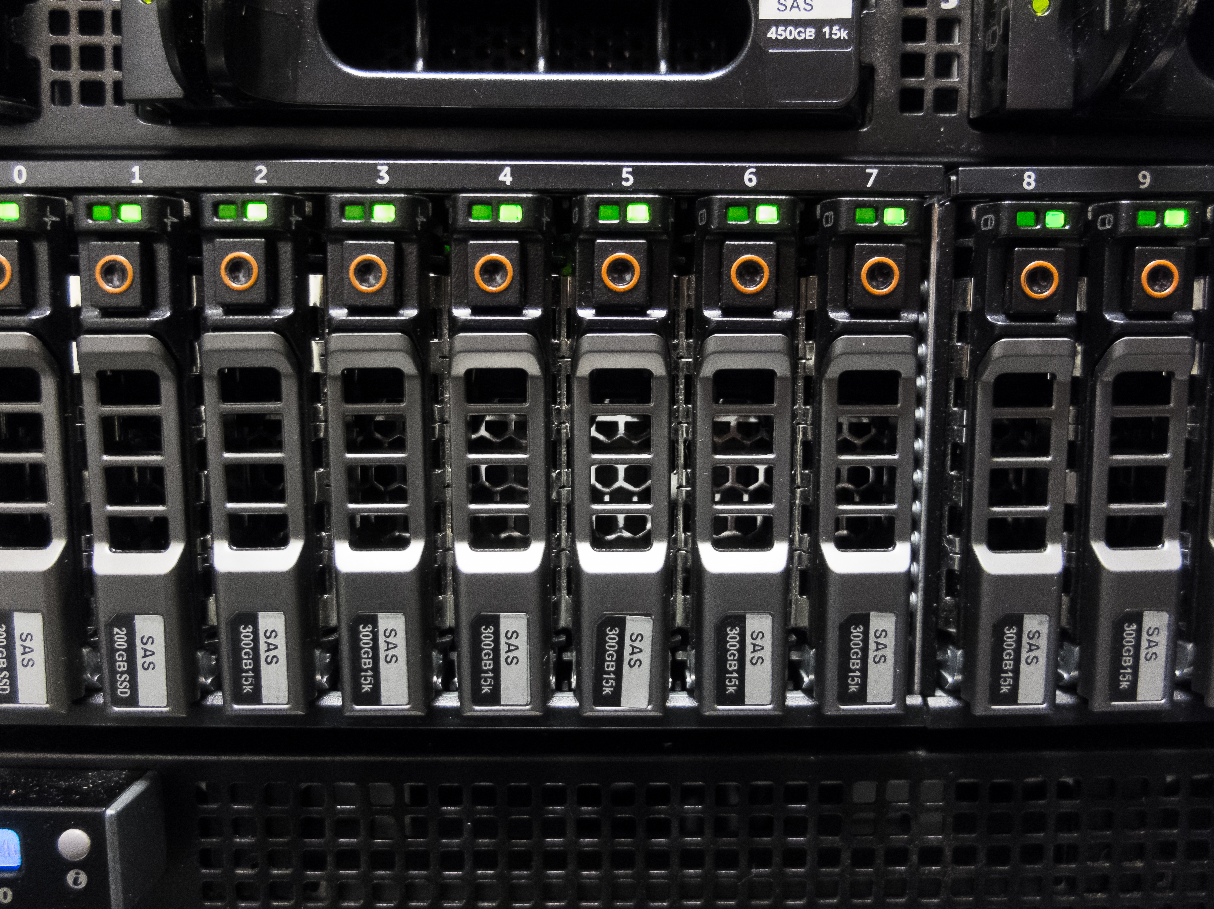
Deduplication

Slide 51

The term deduplication refers generally to eliminating duplicate or redundant information (Wikipedia)

Slide 52

In-line versus Post Process
Source versus Target
File-, Block- or Chunk-Based

Slide 53

How does it work

Slide 54
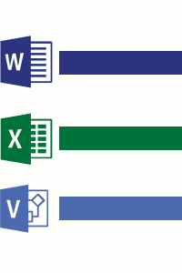

Slide 55
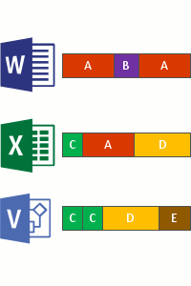

Slide 56
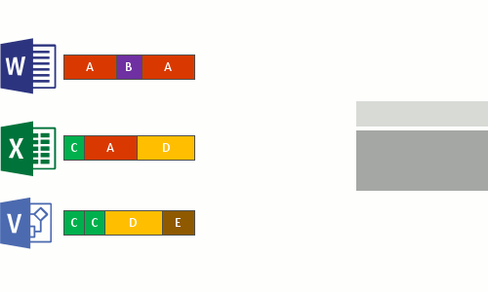

Slide 57
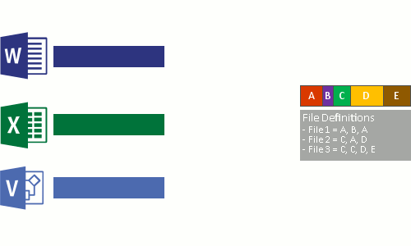

Slide 58

Plan!

Slide 59

Great:
{ File share | Virtualization Files | OS deploy files | Backup Files }
Maybe:
{ LOB | Web Servers | HPC |Static content providers }
Poor:
{ Hyper-V hosts | WSUS | SQL / Exchange Servers | Files > 1TB}

Slide 60
Installation

Slide 61
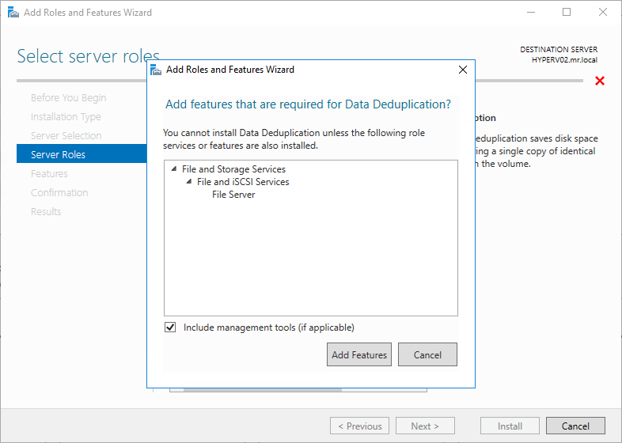

Slide 62
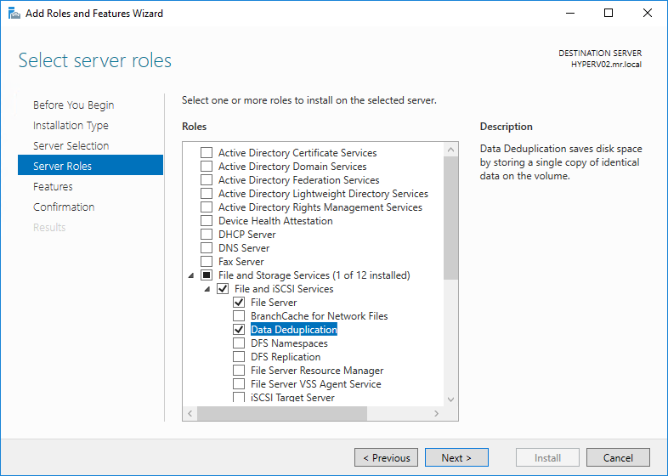

Slide 63
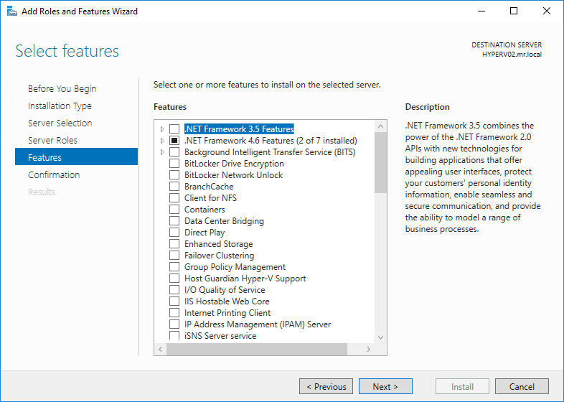

Slide 64
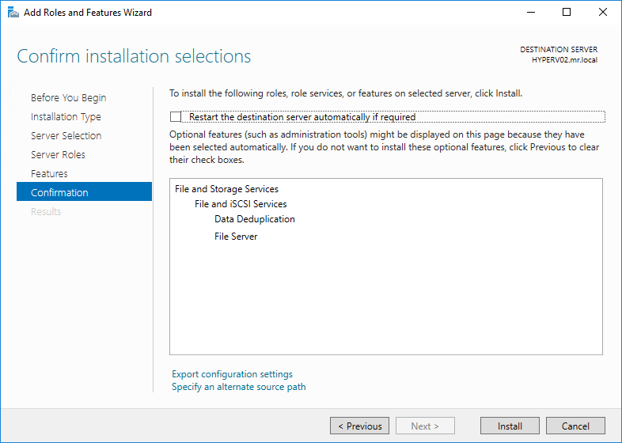

Slide 65
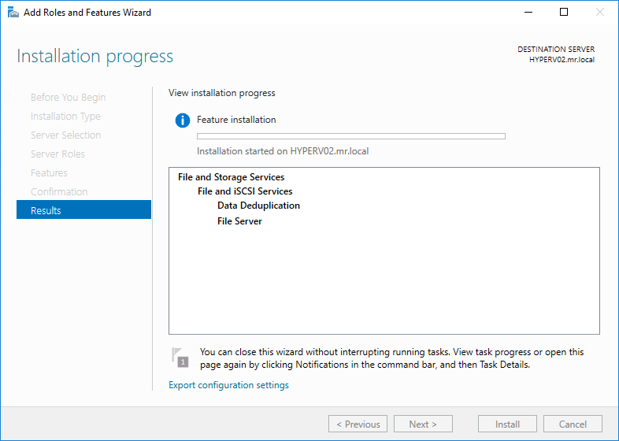

Slide 66
PowerShell
Install-WindowsFeature -Name FS-Data-Deduplication

Slide 67
Nothing happened YET
Now you can use DDPEVAL

Slide 68
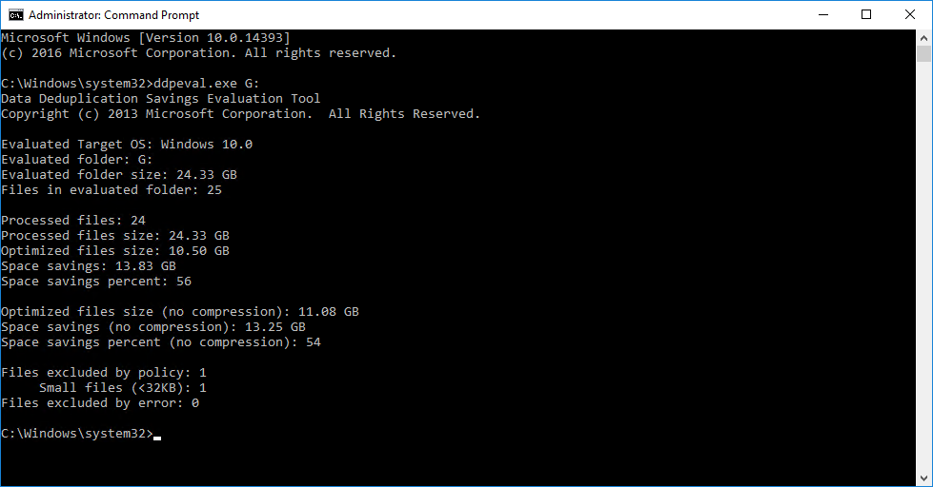

Slide 69
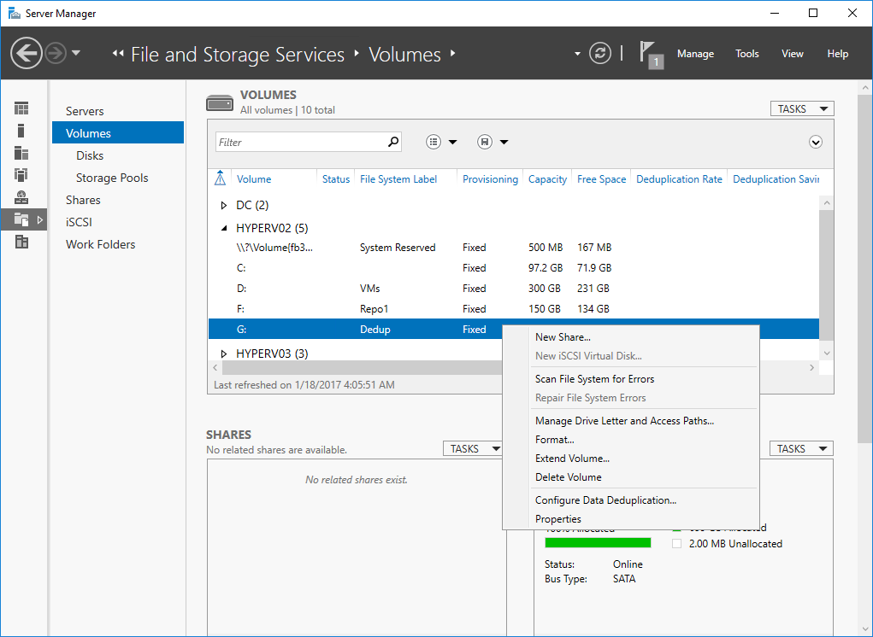

Slide 70
PowerShell
Enable-DedupVolume -Volume <Volume-Path> -UsageType <Selected-Usage-Type>

Slide 71
Usage Type?
Type | Ideal Workloads | Differences
Default | General purpose file server: Team shares Work Folders Folder redirection Software development shares | Background optimization Default optimization policy: Minimum file age = 3 days Optimize in-use files = No Optimize partial files = No

Slide 72
Usage Type?
Type | Ideal Workloads | Differences
Hyper-V | Virtualized Desktop Infrastructure (VDI) servers | Background optimization Default optimization policy: Minimum file age = 3 days Optimize in-use files = Yes Optimize partial files = Yes "Under-the-hood" tweaks for Hyper-V interop

Slide 73
Usage Type?
Type | Ideal Workloads | Differences
Backup | Virtualized backup applications | Priority optimization Default optimization policy: Minimum file age = 0 days Optimize in-use files = Yes Optimize partial files = No "Under-the-hood" tweaks for interop with DPM/DPM-like solutions

Slide 74
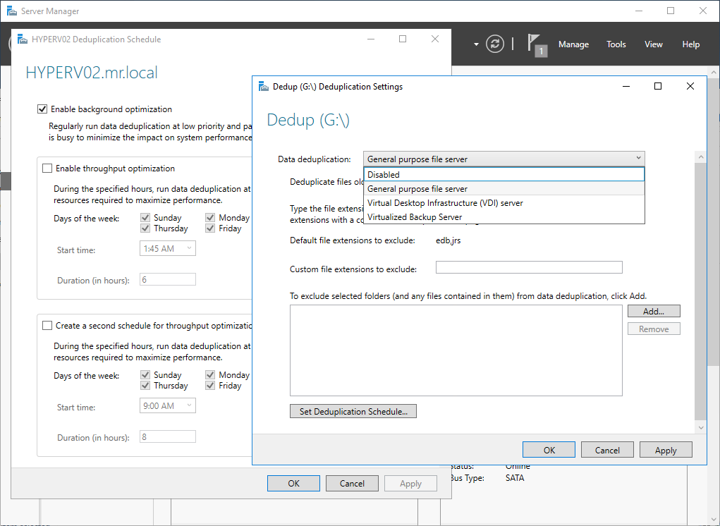

Slide 75
PowerShell is your friend
# What commands?
Get-Command –Module Deduplication
# Enables data deduplication on one or more volumes
Enable-DedupVolume -Volume "G:" -UsageType Backup
Start-DedupJob -Type Optimization -Memory 50 -Cores 2
# Disables data deduplication activity on one or more volumes
Disable-DedupVolume -Volume G:
# Expands an optimized file into its original location
Expand-DedupFile -Path 'G:\02 - VBO Backup\02 - VBO BackupD2017-01-08T230032.vib'
# Returns status and information for currently running or queued deduplication jobs
Get-DedupJob -Type Optimization
# Returns metadata for volumes that have data deduplication metadata.
Get-DedupMetadata -Volume "G:"
# Returns the deduplication job schedule defined on the computer.
Get-DedupSchedule -Type GarbageCollection
# Returns deduplication status for volumes that have data deduplication metadata.
Get-DedupStatus -Volume G:
# Returns deduplication volumes that have data deduplication metadata.
Get-DedupVolume -Volume G:
# Measures potential disk space on a volume.
Measure-DedupFileMetadata -Path G:\
# Creates a data deduplication schedule.
New-DedupSchedule -Name MikeSchedule -Type Optimization -Days Saturday,Sunday -Start 10:00 -DurationHours 8
Get-DedupSchedule
# Changes configuration settings for data deduplication schedules.
Set-DedupSchedule -Name MikeSchedule -Days Saturday,Sunday,Monday
Get-DedupSchedule

Slide 76
PowerShell is your friend
# Deletes a deduplication schedule.
Remove-DedupSchedule -Name MikeSchedule
Get-DedupSchedule
# Changes data deduplication settings on one or more volumes.
Set-DedupVolume -Volume G: -ExcludeFolder G:\Backups
# Starts a data deduplication job.
Start-DedupJob -Volume "G:" -Type Optimization –Memory 5
# Cancels one or more specified data deduplication jobs.
Stop-DedupJob -Volume "G:"
# Scans volumes for fresh data deduplication savings
Update-DedupStatus -Volume G:

Slide 77
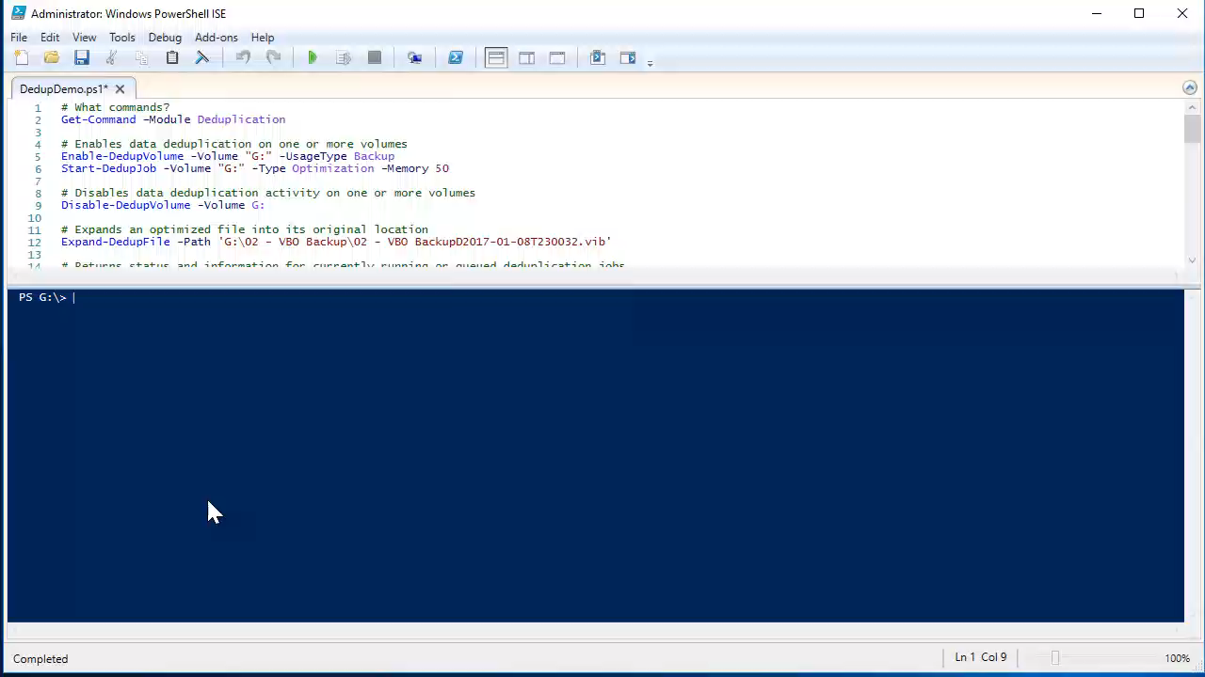

Slide 78
Jobs
Name | Description | Schedule
Optimization | The Optimization job deduplicates by chunking data on a volume per the volume policy settings, (optionally) compressing those chunks, and storing chunks uniquely in the chunk store. | Once every hour
Unoptimization | The Unoptimization job, which is a special job that should only be run manually, undoes the optimization done by deduplication and disables Data Deduplication for that volume. | On-demand

Slide 79
Jobs
Name | Description | Schedule
Garbage Collection | The Garbage Collection job reclaims disk space by removing unnecessary chunks that are no longer being referenced by files that have been recently modified or deleted. (2 types) | Every Saturday at 2:35 AM
Integrity Scrubbing | identifies corruption in the chunk store due to disk failures or bad sectors. When possible, DD can automatically use volume features to reconstruct the corrupted data. Additionally, DD keeps backup copies of popular chunks when they are referenced more than 100 times in an area called the hotspot. | Every Saturday at 3:35 AM

Slide 80
Available job-wide settings
Parameter name | Definition | Accepted values | Why?
Type | The type of the job that should be scheduled | Optimization GarbageCollection Scrubbing | This value is required because it is the type of job that you want to have be scheduled. This value cannot be changed after the task has been scheduled.
Priority | The system priority of the scheduled job | High Medium Low | This value helps the system determine how to allocate CPU time. High will use more CPU time, low will use less.
Days | The days that the job is scheduled | An array of integers 0-6 representing the days of the week. (0 = Sunday) | Scheduled tasks have to run on at least one day.
Cores | The percentage of cores on the system that a job should use | Integers 0-100 (indicates a percentage) | To control what level of impact a job will have on the compute resources on the system
DurationHours | The maximum number of hours a job should be allowed to run | Positive integers | To prevent a job for running into a workload's non-idle hours

Slide 81
Parameter name | Definition | Accepted values | Why?
Enabled | Whether the job will run | True/false | To disable a job without removing it
Full | For scheduling a full Garbage Collection job | Switch (true/false) | By default, every fourth job is a full Garbage Collection job. With this switch, you can schedule full Garbage Collection to run more frequently
InputOutputThrottle | Specifies the amount of input/output throttling applied to the job | Integers 0-100 (indicates a percentage) | Throttling ensures that jobs don't interfere with other I/O-intensive processes.
Memory | The percentage of memory on the system that a job should use | Integers 0-100 (indicates a percentage) | To control what level of impact the job will have on the memory resources of the system
Name | The name of the scheduled job | String | A job must have a uniquely identifiable name.
ReadOnly | Indicates that the scrubbing job processes and reports on corruptions that it finds, but does not run any repair actions | Switch (true/false) | You want to manually restore files that sit on bad sections of the disk.
Start | Specifies the time a job should start | System.DateTime | The date part of the System.Datetime provided to Start is irrelevant (as long as it's in the past), but the time part specifies when the job should start.

Slide 82
Parameter name | Definition | Accepted values | Why?
StopWhenSystemBusy | Specifies whether Data Deduplication should stop if the system is busy | Switch (True/False) | This switch gives you the ability to control the behavior of Data Deduplication--this is especially important if you want to run Data Deduplication while your workload is not idle.

Slide 83
Available volume-wide settings
Parameter name | Definition | Accepted values | Why?
ChunkRedundancyThreshold | The number of times that a chunk is referenced before a chunk is duplicated into the hotspot section of the Chunk Store. The value of the hotspot section is that so-called "hot" chunks that are referenced frequently have multiple access paths to improve access time. | Positive integers | The main reason to modify this number is to increase the savings rate for volumes with high duplication. In general, the default value (100) is the recommended setting, and you shouldn't need to modify this.
ExcludeFileType | File types that are excluded from optimization | Array of file extensions | Some file types, particularly multimedia or files that are already compressed, do not benefit very much from being optimized. This setting allows you to configure which types are excluded.
ExcludeFolder | Specifies folder paths that should not be considered for optimization | Array of folder paths | If you want to improve performance or keep content in particular paths from being optimized, you can exclude certain paths on the volume from consideration for optimization.

Slide 84
Parameter name | Definition | Accepted values | Why?
InputOutputScale | Specifies the level of IO parallelization (IO queues) for Data Deduplication to use on a volume during a post-processing job | Positive integers ranging 1-36 | The main reason to modify this value is to decrease the impact on the performance of a high IO workload by restricting the number of IO queues that Data Deduplication is allowed to use on a volume. Note that modifying this setting from the default may cause Data Deduplication's post-processing jobs to run slowly.
MinimumFileAgeDays | Number of days after the file is created before the file is considered to be in-policy for optimization. | Positive integers (inclusive of zero) | The Default and HyperV usage types set this value to 3 to maximize performance on hot or recently created files. You may want to modify this if you want Data Deduplication to be more aggressive or if you do not care about the extra latency associated with deduplication.
MinimumFileSize | Minimum file size that a file must have to be considered in-policy for optimization | Positive integers (bytes) greater than 32 KB | The main reason to change this value is to exclude small files that may have limited optimization value to conserve compute time.
NoCompress | Whether the chunks should be compressed before being put into the Chunk Store | True/False | Some types of files, particularly multimedia files and already compressed file types, may not compress well. This setting allows you to turn off compression for all files on the volume. This would be ideal if you are optimizing a dataset that has a lot of files that are already compressed.

Slide 85
Parameter name | Definition | Accepted values | Why?
NoCompressionFileType | File types whose chunks should not be compressed before going into the Chunk Store | Array of file extensions | Some types of files, particularly multimedia files and already compressed file types, may not compress well. This setting allows compression to be turned off for those files, saving CPU resources.
OptimizeInUseFiles | When enabled, files that have active handles against them will be considered as in-policy for optimization. | True/false | Enable this setting if your workload keeps files open for extended periods of time. If this setting is not enabled, a file would never get optimized if the workload has an open handle to it, even if it's only occasionally appending data at the end.
OptimizePartialFiles | When enabled, the MinimumFileAge value applies to segments of a file rather than to the whole file. | True/false | Enable this setting if your workload works with large, often edited files where most of the file content is untouched. If this setting is not enabled, these files would never get optimized because they keep getting changed, even though most of the file content is ready to be optimized.
Verify | When enabled, if the hash of a chunk matches a chunk we already have in our Chunk Store, the chunks are compared byte-by-byte to ensure they are identical. | True/false | This is an integrity feature that ensures that the hashing algorithm that compares chunks does not make a mistake by comparing two chunks of data that are actually different but have the same hash. In practice, it is extremely improbable that this would ever happen. Enabling the verification feature adds significant overhead to the optimization job.

Slide 86
Available system-wide settings
Parameter name | Definition | Accepted values | Why?
WlmMemoryOverPercentThreshold | This setting allows jobs to use more memory than Data Deduplication judges to actually be available. For example, a setting of 300 would mean that the job would have to use three times the assigned memory to get canceled. | Positive integers (a value of 300 means 300% or 3 times) | If you have another task that will stop if Data Deduplication takes more memory.
DeepGCInterval | This setting configures the interval at which regular Garbage Collection jobs become full Garbage Collection jobs. A setting of n would mean that every nth job was a full Garbage Collection job. Note that full Garbage Collection is always disabled (regardless of the registry value) for volumes with the Backup Usage Type. | Integers (-1 indicates disabled) | FGC compacts every container even if just a single chunk in the container is unreferenced. FGC will also free space that may have been in use if there was a crash or power failure during an Optimization job. FGC jobs will recover 100 percent of the available space that can be recovered on a deduplicated volume at the cost of requiring more time and system resources compared to a regular GC job. The FGC job will typically find and release up to 5 percent more of the unreferenced data than a regular GC job. The default schedule of the FGC job is to run every fourth time GC is scheduled.

Slide 87

Benefits
50-60% - General
1.0
30-50% - Documents
1.0
70-80% - Application
80-95% - VHD Library

Slide 88

Failover Clustering
Storage Replica
BranchCache
DFS Replication
Quota
Windows Server Backup

Slide 89
Windows 10
Windows Search
RoboCopy

Slide 90

Performance hit?
Picture: flickr.com/photos/glasgows/

Slide 91

Reliable?
Picture: flickr.com/photos/drmartin/

Slide 92

Take Backups!

Slide 93


No… Relax!

Slide 94
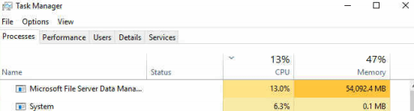
Check the job
Get-Dedupjob / Get-DedupStatus / Get-DedupVolume
Task Manager!

Slide 95
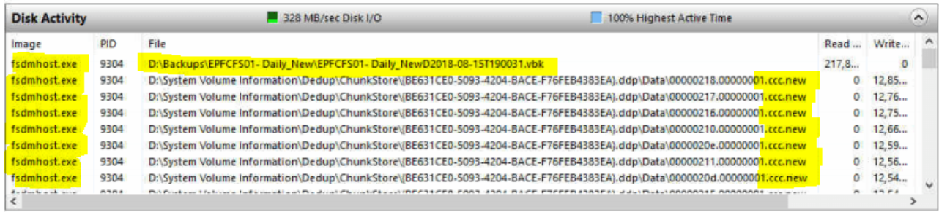
Not fast enough?
https://deploymentbunny.com/2017/04/28/powershell-is-king-a-data-deduplication-script-that-run-the-optimizationgarbage-collection-and-scrubbing-in-a-single-sweep-including-progress/ (Mikael Nystrom)
Check fsdmhost.exe (Thanks Dave Kawula!)

Slide 96

ReFS & Dedup... Together?

Slide 97
Slides and demos from the conference will be available at
https://github.com/nordicinfrastructureconference/2019

Slide 98


